Slide 1
Segnet Performance of Traversability Set

Slide 2
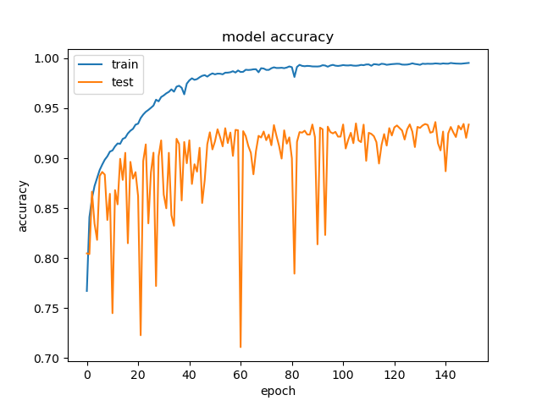

Slide 3
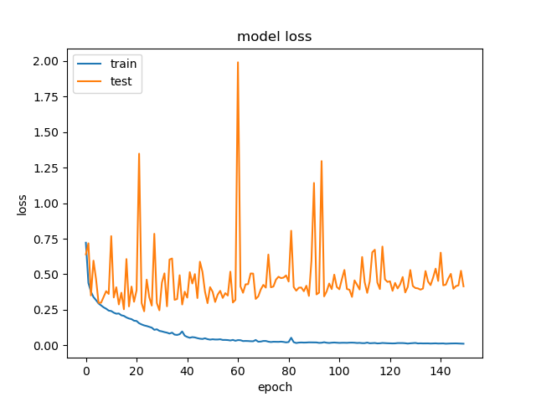

Slide 4
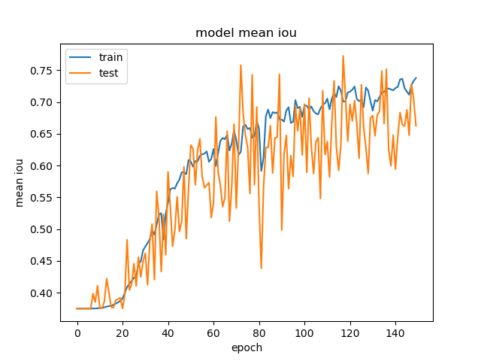

Slide 5
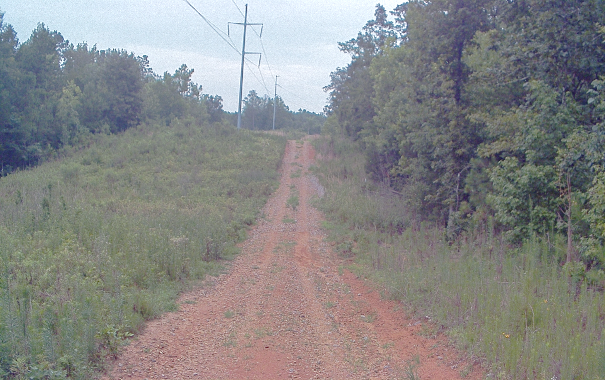


Slide 6



Slide 7


Notes:
Remove small sections make continuous

Slide 8



Slide 9



Slide 10
